Slide 1
Projects & Services Committee -
Mike Tobin, Director of Operations
August 28, 2023

Slide 2
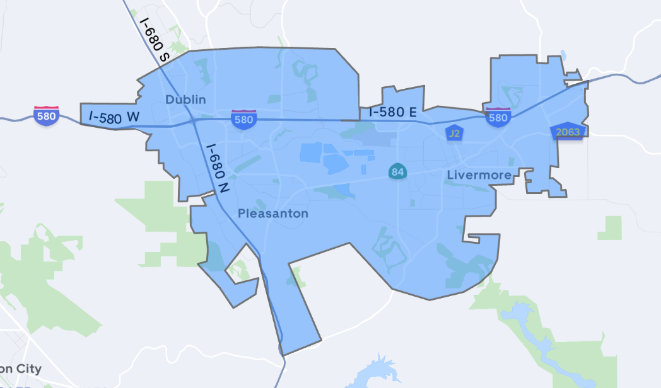
Item 5 – Go Tri-Valley Contract Amendments
Subsidized trips – 50% of the trip up to $5
Began as Go Dublin, expanded to entire service area
Supplemental mobility option
Marketing campaign in February

Slide 3
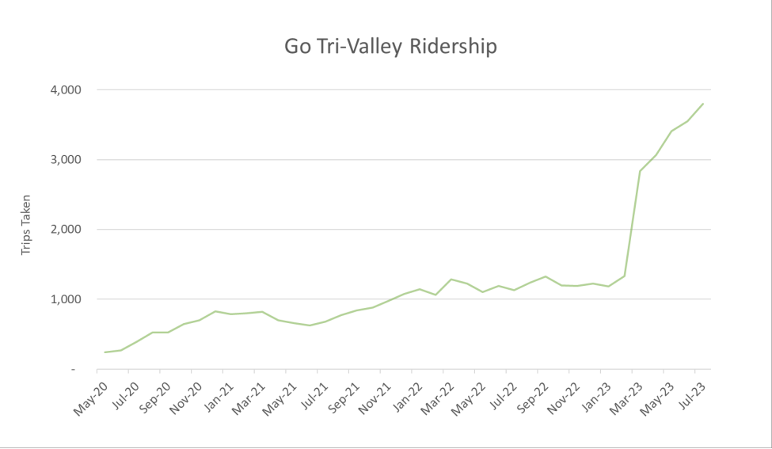

Slide 4
Recommendation
Staff requests that the Projects and Services Committee recommend the Board of Directors authorize the Executive Director to execute amendments to the Go Tri-Valley contracts with Lyft, Inc. and Uber Technologies, Inc. to extend the contract terms and accommodate the increased ridership and subsequent annual program costs.

Slide 5
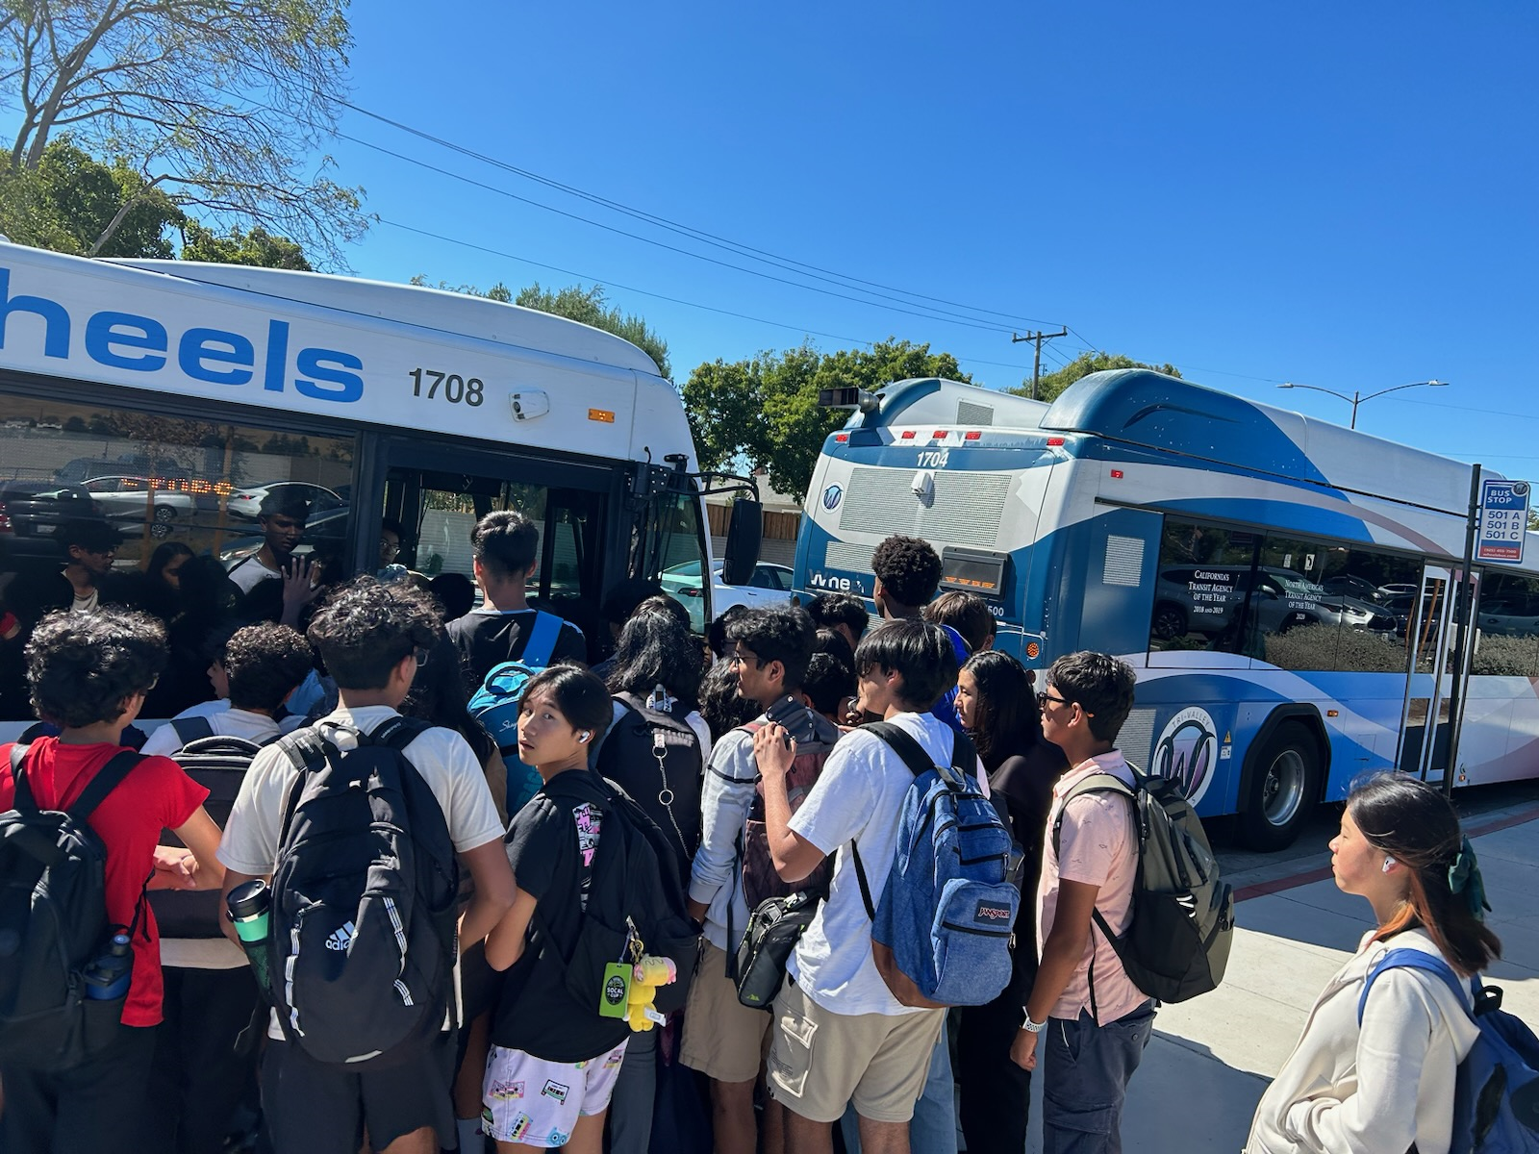
Item 6 – Update on start of school service
August 10th
Ambassadors
OTP issues
Passenger Loads
Route 501 – additional trip?
Route 502 – schedule change
Route 604 – added earlier trip
Trees at Dublin High School

Slide 7
Questions and Discussion

